Slide 1

Comparative Federalism and … the European Union
Seminar 1: US Federalism: Foundations
Seminar 2 : German Federalism (and British Unitarism)
Seminar 3: EU Federalism I: Foundations
Seminar 4: EU Federalism II: Dual or Cooperative?
Supported by the ERC EU Framework Programme 2007-13: ERC Grant Agreement No. 312304

Slide 2
Day 1: Lectures 1-2
Introduction
US Federalism: History and Structure
German Federalism: History and Structure
(British “Federalism: History and Structure)

Slide 3
Introduction
No theory of federalism in antiquity
No „medieval“ theory of federalism
Modern federalism emerges with the rise of the (European) State system. This legal „pluralism“ provides the background to theories of „Unions of States“. Federalism comes to refer to legal arrangements between territorically distinct political communities. The „federal principle“ refers to international and contractual relations between States.

Slide 4
The „Classic“ Tradition (1)
State Sovereignty: there can be no „higher“ authority beyond the State. „Every nation that governs itself, under what form soever, without dependence on any foreign power, is a Sovereign State“ (Vattel)
How could classic international law explain the „Federal Unions“, like thr Swiss Confederacy, the United Provinces of the Netherlands, and the German Empire? It makes a distinction between „Federal Union“ and a „unitary State“. Federal Unions respect the sovereignty of its members and – in principle – operate by unanimity.

Slide 5
The „Classic“ Tradition (2)
Definition in Vattel‘s „Law of Nations“
    § 10. Of States forming a Federal Republic
    Finally, several sovereign and independent States may unite themselves together by a perpetual confederacy, without ceasing to be, each individually, a perfect State. They will together constitute a federal republic: their joint deliberations will not impair the sovereignty of each member, though they may, in certain respects, put some restraint on the exercise of it, in virtue of voluntary engagements. A person does not cease to be free and independent, when he is obliged to fulfil engagements which he has voluntarily contracted. Such were formerly the cities of Greece; such are at present the Seven United Provinces of the Netherlands, and such the members of the Helvetic body.

Slide 6
The „Classic“ Tradition (3)
But why would States wish to federalise?
In ‘The Spirit of the Laws’, de Montesquieu advanced a concrete reason for republics to federate. ‘If a republic is small, it is destroyed by a foreign force; if it is large, it is destroyed by an internal vice.’ To overcome this ‘dual drawback’, democracies would need to combine ‘all the internal advantages of republican government and the external force of monarchy’. Composed of small republics, the ‘federal republic’ thus ‘enjoys the goodness of internal government of each one; and, with regard to the exterior, it has, by the force of the association, all the advantages of large monarchies’.

Slide 7
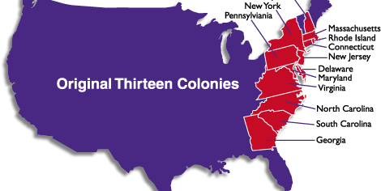
The United States… then:

Slide 8
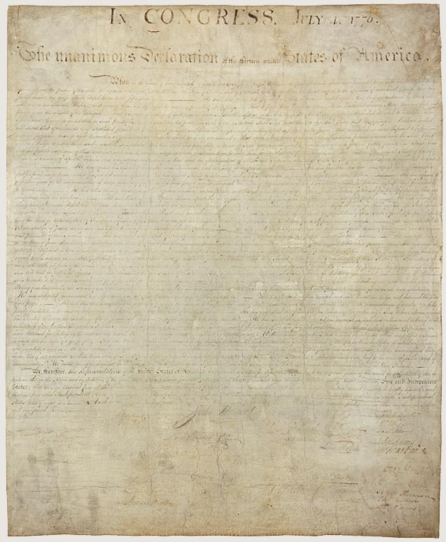
Declaration of Independence

Slide 9
2. US Federalism: History and Structure
a. Divided Sovereignty & Constitutional Conflicts
b. Dual and Cooperative Federalism
c. Case Analysis

Slide 10
„American“ Federalism (1)
There are two American Unions in the eighteenth century – one established by the 1777 Articles of Confederation and the second established by the 1787 Constitution.
The „Articles of Confederation“ still breathed the „international“ format of the federal principle. Article II: „Each State retains its sovereignty, freedom, and independence[.]“ And in Article III, the thirteen colonies promise to „hereby severally enter into a firm league of friendship with each other, for their mutual defense ... binding themselves to assist each other, against all force offered to, or attacks made upon them, or any of them“.

Slide 11
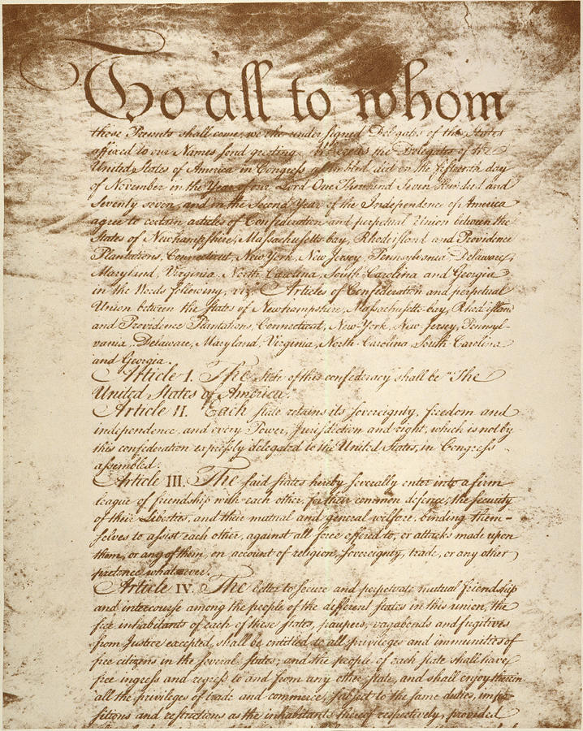
Articles of Confederation

Slide 12
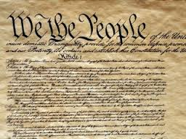
1787 US Constitution

Slide 13
The „American Tradition“ (2)
What would the 1787 Constitution do? It would trigger a departure from the „international“ meaning of federalism. Thereafter, federalism becomes identified with the American constitutional system as such.
But what was the structure of that system? The „authoritative“ analysis of that question is offered by „The Federalist“, and in particular Paper No 39. Here, J Madison analyses the American Union alongside three dimensions: a „foundational“ dimension, an „institutional“ dimension, and a „substantive“ dimension. Federalism becomes identified with the „middle ground“ between international and national law.

Slide 14
Federalist No.39 (1)
Foundational Dimension
    Unanimous assent of the States: „Each state in ratifying the Constitution, is considered as a sovereign body, independent of all others, and only to be bound by its own voluntary act.“
    „We, the people“ or „We, the peoples ...“?
    The amendment power under Article V: 2/3 Congress and ¾ States.

Slide 15
Federalist No.39 (2)
Institutional Dimenision
    The „great compromise“: the Union legislature will be bicameral Congress is composed of a „House of Representatives“ and a „Senate“. Each law needs consent of both branches.
    The „President“: an elective monarch (and its „agents“ and „agencies“)
    The „Judiciary“: the Supreme Court (and lower federal courts).

Slide 16
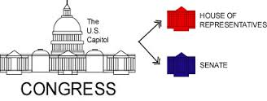
Example: Congress

Slide 17
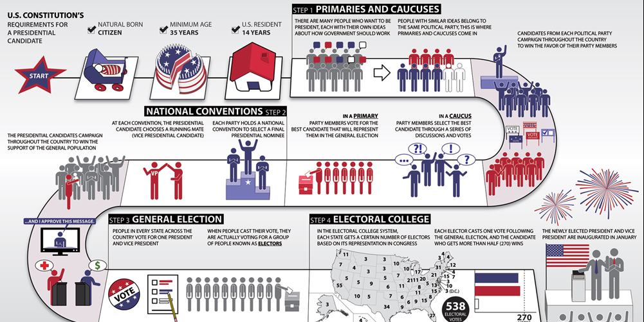
Example: Electing the US President

Slide 18
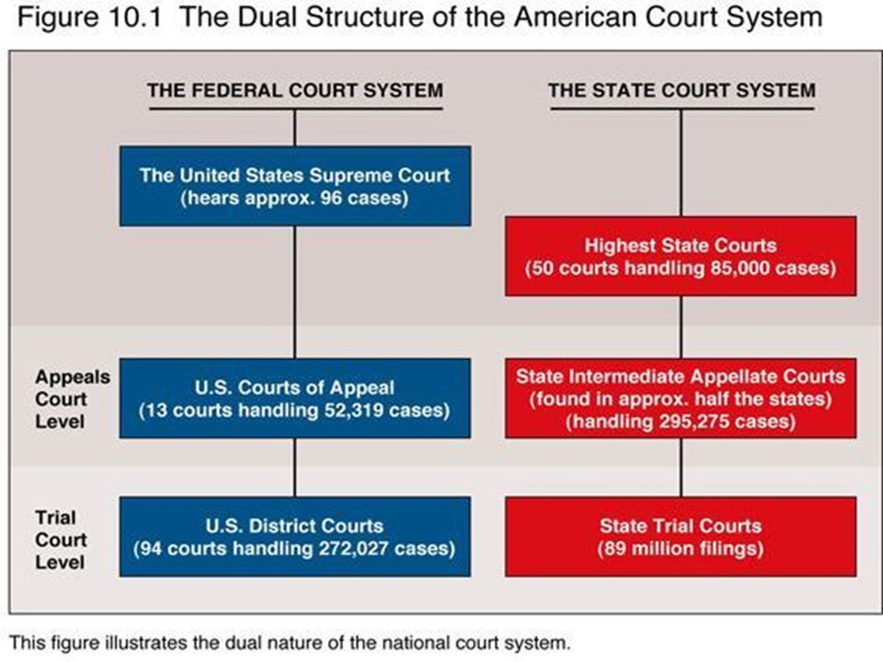
Federal Judiciary
The judicial power of the United States, shall be vested in one Supreme Court, and in such inferior courts as the Congress may from time to time ordain and establish. The judges, both of the supreme and inferior courts, shall hold their offices during good behaviour, and shall, at stated times, receive for their services, a compensation, which shall not be diminished during their continuance in office.

Slide 19
Federalist No.39 (3)
Substantive Dimension
    Federal powers are enumerated powers. Residual powers lie with the States. The list of legislative competences is established by Article I, Section 8, which states: „The Congress shall have power…”
        Power to lay taxes, duties ...
        Regulate commerce
        To coin money, fix the standards of weights...
        To declare war
        „To make all Laws which shall be necessary and proper for carrying into execution the foregoing powers“
        18 clauses....
    Direct effect of federal laws on individuals

Slide 20
The „American Tradition“ (4)
Summary and Evaluation:
Federalism as dual government... and „dual sovereignty“. Sovereignty is divided between the „Union“ and its „States“. This view infuences Swiss federalism as well as German federalism.
But, the „European“ tradition is overshadowed by the nineteeenth-century obsession with sovereign States. Federalism is reduced to the „Federal State“. We shall talk about that next week...

Slide 21
Divided Sovereignty & Constitutional Conflicts
Question(s):
The aim of the 1787 Constitution had been ‘to divide the sovereign authority into two parts’. ‘This idea of the divisibility of sovereignty had emerged at the time of the Federal Convention, and was a distinctly American theory’. Each State would give up part of its sovereignty; the ‘nation’, on the other hand, would remain ‘incomplete’. While sovereignty lay ultimately in ‘the people’, the Constitution had been delegated to and divided between two levels of government. Who, then, was the ‘sovereign’? The ‘We the people’ formula had left the identity of the popular sovereign ‘indeterminate’. The formula simply acknowledged that the Americans had rejected the British concept of governmental sovereignty. Sovereignty meant popular sovereignty. But who were ‘the people’: the peoples of the United States, or the people of the United States? What would happen where the visions of the State people(s) and the ‘American people’ diverged?

Slide 22
Constitutional Conflicts before Civil War (1)
The Alien and Sedition Crisis
In 1798, the federal government enacted the Alien and Sedition Acts. The Acts allowed the Union, through its president, to adopt emergency measures. These could result in extreme limitations of personal liberties. Two States regarded the federal laws as violations of the Bill of Rights.
Their constitutional discontent expressed itself through resolutions. The Virginia and Kentucky Resolutions reignited the final arbiter question. The Virginia protest – secretly drafted by James Madison – elaborated the theory of interposition and (re)stated the view of the Constitution as compact between the States. This constitutional protest was joined by the Kentucky legislature. But the tone of the Kentucky Resolutions was stronger. They bore the imprint of Thomas Jefferson – then Vice President of the United States

Slide 23
Alien & Sedition Act (2)
1798 Kentucky Resolution
[t]hat the several states composing the United States of America, are not united on the principle of unlimited submission to their general government; but that by compact under the style and title of a Constitution for the United States. ... [T]he government created by this compact was not made the exclusive or final judge of the extent of the powers delegated to itself; since that would have made its discretion, and not the Constitution, the measure of its powers; but that as in all other cases of compact among powers having no common Judge, each party has an equal right to judge for itself, as well of infractions as of the mode and measure of redress.

Slide 24
Constitutional Conflicts before the Civil War (2)
The “Tariff of Abominations”
The agricultural South here protested against a federal tariff that was claimed to favour the industrial North. South Carolina ‘exposed’ its anger. The South Carolina ‘Exposition and Protest’ (1828) was a brainchild of John Calhoun – then Vice president of the United Sates. It challenged the competence of the federation to adopt the federal tariff and claimed the ‘discriminatory tariff’ was unconstitutional.
The Exposition hereby returned to the quintessential federal question: who was the ultimate arbiter of the Union’s competences? What constitutional safeguards would protect the States against a federal usurpation? The Exposition’s answer was the theory of nullification. While Calhoun tried to portray nullification as a logical extension of the (Madisonian) theory of interposition, the former was a – radical – step beyond the latter. The theory of nullification derived from the (European) theory of – undivided – state sovereignty.

Slide 25
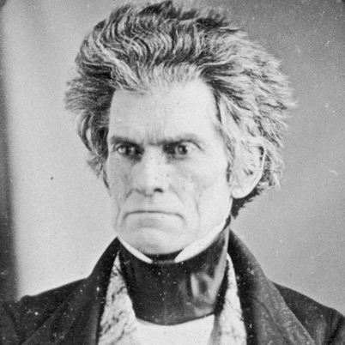
South Carolina “Exposition”
“If it be conceded, as it must be by every one who is the least conversant with our institutions, that the sovereign powers delegated are divided between the General and State Governments, and that the latter hold their portion by the same tenure as the former, it would seem impossible to deny to the States the right of deciding on the infractions of their powers, and the proper remedy to be applied for their correction. The right of judging, in such cases, is an essential attribute of sovereignty—of which the States cannot be divested without losing their sovereignty itself—and being reduced to a subordinate corporate condition. (…)
But the existence of the right of judging of their powers, so clearly established from the sovereignty of States, as clearly implies a veto or control, within its limits, on the action of the General Government, on contested points of authority; and this very control is the remedy which the Constitution has provided to prevent the encroachments of the General Government on the reserved rights of the States

Slide 26

The “National” Reaction to South Carolina
D. Webster’s “The Constitution Not a Compact between Sovereign States”
Who is to construe finally the Constitution of the United States? We all agree that the Constitution is the supreme law; but who shall interpret that law? (…) In my opinion, Sir, even if the Constitution of the United States had made no express provision for such cases, it would yet be difficult to maintain, that, in a Constitution existing over four-and-twenty States, with equal authority over all, one could claim a right of construing it for the whole. This would seem a manifest impropriety; indeed, an absurdity. (…) Congress must judge of the extent of its own powers so often as it is called on to exercise them, or it cannot act at all; and it must also act independent of State control, or it cannot act at all. The right of State interposition strikes at the very foundation of the legislative power of Congress. It possesses no effective legislative power, if such right of State interposition exists; because it can pass no law subject to abrogation.

Slide 27

The Civil War and its Aftermath
The doctrine of State sovereignty emerged strengthened from the tariff crisis. It would, in the following decades, gain respectability in constitutional politics. With the slavery question hardening into a divisive constitutional conflict, it was a matter of time until the manufacturing North and the agricultural South would fatally clash. South Carolina took the final step in 1860 and adopted the ‘Ordinance to dissolve the union between the State of South Carolina and the other States united with her under the compact entitled “The Constitution of the United States of America”’.
Ten States would follow its lead. For the North this was a ‘rebellion’. The contrasting constitutional visions between the North and the South on the question of sovereignty led to the ‘Civil War’. Lincoln’s North won the Civil War. This extra-constitutional ‘fact’ henceforth discredited the theory of State sovereignty.

Slide 28
b. Dual and Cooperative Federalism
Introduction
The 1787 Constitution allowed the federal government to act directly on the people. But what was the scope of the federal powers and how did they relate to the powers „inherent“ in the States? The Articles of Confederation had answered this in the text, when it attributed „the sole and exclusive right and power“ to act to the United States in certain fields. But what was the relationship between the federal and the State powers under the 1787 Constitution? Two – extreme – views came to compete: the „international“ and the „national view“. It was a compromise – third – view that would come to be accepted: dual federalism.

Slide 29
Dual Federalism: Overview
Dual Federalism – Dual Sovereignty
Dual federalism accepts the idea of autonomous national powers. Dual federalism here aligned itself with the idea of dual sovereignty: “The United States are sovereign as to all the powers of government actually surrendered: Each State in the Union is sovereign as to all the powers reserved“ (Chisholm v State of Georgia, 1793). There are two mutually exclusive spheres of power: „[T]he powers of the General Government, and of the State, although both exist and are exercised within the same territorial limits, are yet separate and distinct sovereignties, acting separately and independently of each other within their respective spheres“ (Ableman v Booth, 1859).

Slide 30
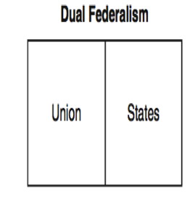
Example: Commerce Clause
How did dual federalism work? The best illustration may be found in the U.S. Supreme Court‘s jurisprudence on the „Commerce Clause“. This clause gives the Union the power „to regulate Commerce with foreign nations, and among the several States“ – Article I, Section 8, Clause 3). So, where did interstate commerce begin and internal commerce end? Dual federalism tries to balance between the powers of both levels of government by safeguarding sovereign „enclaves“ for each.

Slide 31
Dual Federalism (3)
United States v Knight (1895): „Commerce“ versus „Manufacture“
“It cannot be denied that the power of a state to protect the lives, health, and property of its citizens, and to preserve good order and the public morals, “the power to govern men and things within the limits of its dominion,” is a power originally and always belonging to the states, not surrendered by them to the general government, nor directly restrained by the constitution of the United States, and essentially exclusive’. ‘It is vital that the independence of the commercial power and of the police power, and the delimitation between them, however sometimes perplexing, should always be recognized and observed, for, while the one furnishes the strongest bond of union, the other is essential to the preservation of the autonomy of the states as required by our dual form of government[.]” “Commerce succeeds manufacture, and is not a part of it.”
“Police Powers”

Slide 32
Dual Federalism (4)
Hammer v Dagenhart (1918)
„Regulation“ versus „prohibition“. Could the federation prohibit interstate commerce in a product? Could the Child Labor Act standardize the ages at which children could be employed in mining and manufacture? The Supreme Court found: „no“! The power to „regulate“ commerce was „directly the contrary to the assumed right to forbid commerce from moving and thus destroying it as to particular commodities“.

Slide 33
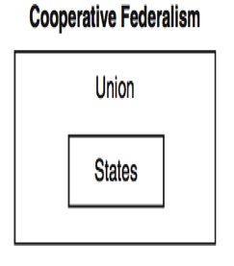
Cooperative Federalism
The New Nationalism (1)
Reforms follow crises. The reformation of American federalism followed the Great Depression of 1929. The nation was in economic danger and only a “new nationalism” could help it revitalise the economy. The result is the “New Deal”. The “new federalism” enters into “State domains”. Within these fields the federation and the States co-legislate. This is a true “constitutional moment”.

Slide 34
Cooperative Federalism
The New Nationalism (2)
The rise of national power is first expressed through an expansion of federal competences. In its post-New Deal jurisprudence, the Supreme Court abandons the distinction between “commerce” and “production”.
Thus: in Jones v Laughlin (1937), the constitutionality of the National Labor Relations Act (1935) is challenged as an attempt to regulate all industry, thus invalidating the reserved powers of the States over their local concerns”. The Supreme Court now held:
“Although activities may be intrastate in character when separately considered, if they have such a close and substantial relation to interstate commerce that their control is essential or appropriate to protect that commerce from burdens and obstructions, Congress cannot be denied the power to exercise that control.”

Slide 35
Cooperative Federalism
The New Nationalism (3)
In the following fifty years, the Supreme Court dismantles many – if not all – exclusive competences of the States.
  United States v Darby (1941)
  Wickard v Filburn (1942)
  Garcia v San Antonio Metropolitan Transit Authority (1985)

Slide 36
Cooperative Federalism
The New Nationalism (4)
In Garcia, the Supreme Court goes so far as to discard the idea of competence limits on the powers of Congress. Instead, the States would be protected by means of the “political safeguards of federalism”.
    “Apart from the limitation on federal authority inherent in the delegated nature of Congress’ Article I powers, the principal means chosen by the Framers to ensure the role of the States in the federal system lies in the structure of the Federal Government itself. It is no novelty to observe that the composition of the Federal Government was designed in large part to protect the States from overreaching by Congress. The Framers thus gave the States a role in the selection both of the Executive and the Legislative Branches of the Federal Government. The States were vested with indirect influence over the House of Representatives and the Presidency by their control of electoral qualifications and their role in Presidential elections.”

Slide 37
Garcia – continued
    They were given more direct influence in the Senate, where each State received equal representation and each Senator was to be selected by the legislature of his State. The significance attached to the States’ equal representation in the Senate is underscored by the prohibition of any constitutional amendment divesting a State of equal representation without the State’s consent . . .
    Of course, we continue to recognize that the States occupy a special and specific position in our constitutional system and that the scope of Congress’ authority under the Commerce Clause must reflect that position. But the principal and basic limit on the federal commerce power is that inherent in all congressional action—the built-in restraints that our system provides through State participation in federal governmental action. The political process ensures that laws that unduly burden the States will not be promulgated.

Slide 38
Cooperative Federalism
The New Nationalism (5)
The Court thus denied the existence of a constitutionally protected nucleus of exclusive state power. The Tenth Amendment was “but a truism”. The federal balance is entirely left in the hands of the federal legislator. The political process as such ensures that States’ rights are protected.

Slide 39

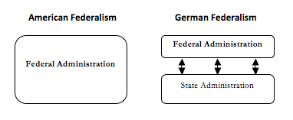
Excursus:
Administrative & Judicial Powers

Slide 40
(Federal) Models
According to the “centralization model”, the administration of federal law is left to federal administrative authorities. In order to enforce its law, the Union thus establishes its own administrative infrastructure (United States). This model has been adopted in the United States of America.
The “decentralisation model” leaves the execution of federal law to the Member States of the Union. The Union’s executive competences are here smaller than its legislative competences. This system of decentralised execution is called “executive federalism”, and has traditionally been adopted in the Federal Republic of Germany.

Slide 41
US: No-Commandeering I
New York v United States
“States are not mere political subdivisions of the United States. State governments are neither regional offices nor administrative agencies of the Federal Government.” Having retained a “residuary and inviolable sovereignty”, the Union cannot “compel the States to enact or administer a federal regulatory program”. While federal legislation is supreme over State legislation, the States – as corporate entities – are not “subordinate” to the Union.

Slide 42
US: No-Commandeering II
Printz v. United States, 521 U.S. 898 (1997)
Scalia: „It is incontestible that the Constitution established a system of "dual sovereignty.". Although the States surrendered many of their powers to the new Federal Government, they retained "a residuary and inviolable sovereignty," The Federalist No. 39, at 245 (J. Madison). (…) We have set forth the historical record in more detail elsewhere, see New York v. United States, 505 U.S., at 161 -166, and need not repeat it here. It suffices to repeat the conclusion: "The Framers explicitly chose a Constitution that confers upon Congress the power to regulate individuals, not States. (…) This separation of the two spheres is one of the Constitution's structural protections of liberty. "Just as the separation and independence of the coordinate branches of the Federal Government serve to prevent the accumulation of excessive power in any one branch, a healthy balance of power between the States and the Federal Government will reduce the risk of tyranny and abuse from either front." (…) The power of the Federal Government would be augmented immeasurably if it were able to impress into its service--and at no cost to itself--the police officers of the 50 States.

Slide 43
Exception: Foreign Affairs (1)
Missouri v Holland (1920) & Curtiss-Wright Export Corp. (1936):
“The two classes of powers are different, both in respect of their origin and their nature. The broad statement that the federal government can exercise no powers except those specifically enumerated in the Constitution, and such implied powers as are necessary and proper to carry into effect the enumerated powers, is categorically true only in respect of our internal affairs.” “[T]he investment of the federal government with the powers of external sovereignty did not depend upon affirmative grants of the Constitution”.

Slide 44
The End – Part 1…

Slide 45
Today: Part II
1. German Federalism I: Legislative Powers
2. German Federalism II: Other Powers
3. British “Federalism”: Devolution
4. Italian Regionalism: A “Quasi-Federal” State?

Slide 46
Introduction
The intellectual history of Germany reaches back into the Middle Ages, but the first modern federation is the 1871 German Empire. The Empire collapses after the First World War and is replaced by the 1919 Weimar Republic. After the Second World War, the Federal Republic of Germany is established by the 1949 “Basic Law” or “Grundgesetz” (GG). The “Preamble” confirms that the nation is divided into states (“Länder”), and Article 20 (1) proclaims Germany to be a federal state (“Bundesstaat”). Article 79 even elevates federalism to an “eternal” value of the German State.

Slide 47
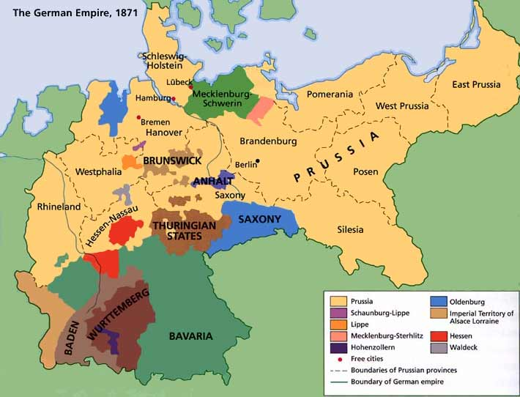
Part I. German Federalism: History (1)

Slide 48
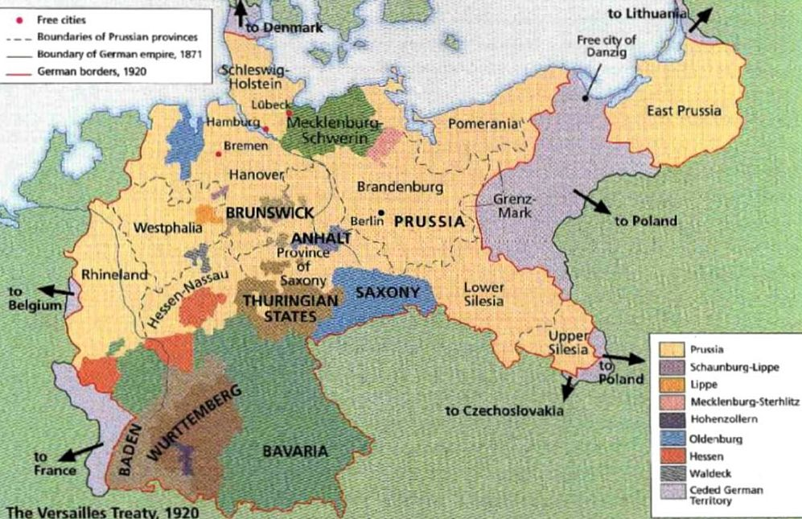
German Federalism: History (2)

Slide 49
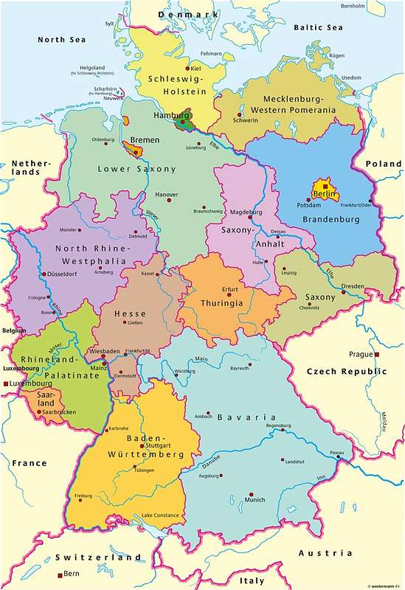
Federal Republic of Germany (1949/90)

Slide 50
A 19th Century German Invention: The Federal „State“
Historically, German federalism has insisted in the indivisibility of sovereignty; and this meant that all „federal“ arrangements needed to be pressed into a dichotomy: either the States had formed a union but retained sovereignty, then the object was an international organisation (confederation = staatenbund); or the States had transferred their sovereignty to a new state: the „federal state“. A federal state was a state that was sovereign but in which legislative competences were divided.

Slide 51
Confederation v Federation
Foundational Dimension
Confederations are based on an „international“ treaty, while federations are formed by a „national“ constitution. How could that explain the formation of the German Empire that was orginally based on a „treaty“? The answer German constitutionalism gives is that the adoption by a national „constitutional convention“ (or Parliament) turns the Treaty into a constitution.
Georg Jellinek
„Nullification and secession, absolutely prohinited within a unitary or federal state, follow logically from the nature of the Confederation as a treaty creature. A sovereign state cannot be bound unconditionally and permanently.“

Slide 52
Member „States“ within a Union
What is the difference between a „State“ within a federation and a decentralised unit within a unitary state?
While the States are not sovereign, they enjoy autonomous legislative competences that allow them to regulate „their“ affairs... And unlike a decentralised unit within a unitary state, the legislative competences cannot be taken back by the Union (without constitutional amendment). But how can the States have autonomous legislative competences, while the Union is sovereign? Answer: the Union has „competence-competence“, that is: it has the potential ability to change the constitution and to absorb all the legislative competences...

Slide 53
Institutional Dimensions:
The “Federal Chamber” (1)
Like in American federalism, the “federal” legislator is composed of two chambers: “Parliament” and the “Council”. No federal law can be adopted without the participation of the “Federal Council”. However, there are three differences to American federalism:
  The German federal chamber is composed of members of the State governments. (After the Thirteenth Amendment, Senators in the US are directly elected.)
  No equal representation, but 3-6 votes.
  There are different modes of legislative involvement for the federal chamber.
      For some laws there is a “suspensive veto”.
      For others the Council enjoys an “absolute veto”.

Slide 54
Federal Chamber (2)
Significant Move from the Suspensive to the Absolute Veto
“The” principal constitutional issue until 2006 has been the problem of the “joint-decision-trap”. What is this? It was originally thought that the Federal Council would – in the majority of cases – only have a suspensive veto. Yet, with every constitutional amendment, new powers tended to be linked to the “absolute veto” procedure and constitutional convention developed according to which national legislation – of whatever form – was given a clause that regulated the administrative execution of federal law. (This was one of the exceptional instances in which an absolute veto was given to the Federal Chamber.) And in the course of fifty years, the exception had become the rule!
2006 Constitutional Reform: “Entangling” the Federal Legislator…

Slide 55
Federal Division of Powers (1)
In all federations, powers are divided; what differs is how they are divided. The American constitution simply allocates certain powers to the federation and, as we saw last week, it was jurisprudence that determined the constitutional principles governing the division of powers. The German Constitution is “explicit” about the division of competences and contains a number of constitutional provisions.
The central provision is Article 30 GC (that is similar to the Tenth Amendment to the US Constitution):
“Except as otherwise provided or permitted by this Basic Law, the exercise of state powers and the discharge of state functions is a matter for the Länder.“

Slide 56
Federal Division of Powers (3)
How are these powers divided? In contrast to the American cooperative federalism, German (and Austrian and Swiss) federalism adheres to a dual federal philosophy… The philosophy of the German Constitutional Court: BVerfGE 36, 193 – Rights of Witnesses
  “A double competence on the basis of which the federation and the Länder could regulate the same matter in different ways, is foreign to the constitutional system of allocation of powers and incompatible with its function of dividing authority.”

Slide 57
Legislative Powers (2)
The “speciality” of German federalism is the recognition of diverse types of competences. Competence typologies are devices to clarify the power relationship between two levels of government. The German legal order has traditionally known 2 types of competences: “exclusive” and “concurrent” competences. Importantly: these distinctions, while theoretically also applicable to the executive and judicial branch, are only mentioned in relation to the legislative function.

Slide 58
Exclusive Competences (1)
Exclusive competences are “legal monopolies”: only one authority is entitled to act. They are thus double edged: their positive side allows the federation to act, while their negative side forbids the States to act in this field. The Constitution lists the federation’s exclusive competences in Article 73. This provision comes close to the list in Article I, Section 8 US Constitution. Its contains the “essential” powers: foreign affairs, defence, citizenship, currency (…).

Slide 59
Concurrent Competences (1)
The policy fields over which the federation has “concurrent” competence are listed in Article 74 (1). This list is extensive and contains thirty six titles (and each title may enumerate multiple subjects). Article 74 (1) (1) lists: “civil law, criminal law, court organization and procedure (except for the correctional law of pretrial detention), the legal profession, notaries, and the provision of legal advice”.
The complexity here relates to the existence of 3 “types” of concurrent competences….

Slide 60
Concurrent Competences (2)
Type 1: “False” Concurrent Competences
  Article 72 (1) tells us: “On matters within the concurrent legislative power, the Länder shall have power to legislate so long as and to the extent that the Federation has not exercised its legislative power by enacting a law.”
  There are two constitutional principles governing concurrent competences that are counter-intuitive: When a federal law is adopted, it always pre-empts State laws within its field. Field-pre-emption is this the mode of German competence federalism. Wherever the federation has adopted legislation, the States cannot have any legislation. (This is not a question of conflict, but dual federalism only investigates the fields into which the federation has entered.)

Slide 61
Concurrent Competences (3)
Type 2: “Limited” Concurrent Competences
  Article 72 (2) connects these to a list in Article 74.
  The exercise of these competences is subject to a “subsidiarity” test. The federation can only exercise these competences “if and to the extent that the establishment of equivalent living conditions throughout the federal territory or the maintenance of legal or economic unity renders federal regulation necessary in the national interest”.
  The subsidiarity test has, in the past fifty years, not been successful. In 1953, the Constitutional Court even declared the test nonjusticiable,: “The question whether there is a need for federal regulations a question for the faithful exercise of legislative discretion that is by its nature nonjusticiable and therefore basically not subject to review by the Constitutional Court.” (Cf. BVerfGE 213, 224).

Slide 62
Concurrent Competences (4)
Derogation Competences as “Real” Concurrent Competences
  In certain fields, listed in Article 72 (3) – such as regional planning or admission to university, the federation now possesses really “concurrent” competence. There is no normative hierarchy between federal legislation and state legislation.
  The lex posterior rule applies: This will give rise to “partial” federal law and legal differentiation as some States may overrule the federal law.

Slide 63
Part II. Executive Powers (1)
Federalism means duplex regimen or “dual government”. This suggests that all three branches of government are duplicated; and this generally is the case, but there are important differences in degree. American federalism adheres to this principles very strongly: federal law is executed by federal agencies, federal law is adjudicated in federal courts.
In German federalism, the duplication of branches of government is very weak in relation to the executive and judicial branch. In Article 83, we read: “The Länder shall execute federal laws in their own right insofar as this Basic Law does not otherwise provide or permit.” The fact that the States principally execute federal law has been referred to as “executive federalism”.

Slide 64
Executive Power: Federal Models

Slide 65
Executive Powers (2)
This system relies on “trust”. But since a “check” is sometimes better than trust, the federation also has a range of constitutional devices to influence and check the Länder in the execution of federal law.
  The Federation can limit the discretion of the States through the adoption of “administrative regulations”: Article 84(2).
  The Federation can “oversee” the execution of federal law by the States by sending federal Commissioners to State executive: Article 84 (3).
  The Federation can decide that a State has violated federal law: Article 84 (4). This will trigger “federal coercion”: Article 37.
  The Federation can issue instructions in particular cases to the highest State authorities: Article 84 (5).

Slide 66
Executive Powers (3)
There is also – exceptionally – the option of direct and indirect federal execution.
  Direct execution: These are areas in which the uniform application of federal law is essential: foreign affairs (foreign office), national defence (the army), the currency (federal bank), telecommunication (federal post), etc. The constitutional regimes is set out in Article 86 and the areas are enumerated in Articles 87 and 89.
  Indirect execution: There is an intermediate form laid down in Article 85 in which the States enforce federal law as agents of the federation (that is: not on their own account).

Slide 67
Judicial Powers
State judges may not like federal law. The U.S. Constitution therefore envisages the establishment of lower federal courts. And again: Germany has not followed this development and relies predominantly on State courts for the application of federal laws. Federal courts are courts of appeal. They are at the apex of each jurisdiction. German scholars do not fear that this undermines the supremacy of federal law – even if appeals are not an ideal way of establishing uniformity.

Slide 68
Foreign Affairs Powers
For much of the nineteenth century, both the German Union and its Member States enjoyed the ius bellum and the ius tractatum. Beginning with the 1871 Imperial Constitution, foreign affairs are increasingly centralized. The central provision for international treaties is today Article 32 of the 1949 German Constitution: “Relations with foreign states shall be conducted by the Federation. …Insofar as the Länder have power to legislate, they may conclude treaties with foreign states with the consent of the Federal Government.

Slide 69
Foreign Affairs Powers (2)
What is the scope of the treaty power in Germany? Three views still compete in German constitutional thought: the “Berlin view”, the “South German view”, and the “North German view”.
The Lindau Accord as a modus vivendi. Article 3:
“International treaties falling within areas of exclusive competence of the Member States, which are intended to become binding on the Federation or the Member States, require the consent of the Member States. The consent shall be submitted before the treaty becomes binding under international law.”

Slide 70
Part III. British “Federalism”
History: England & Wales
In the seventeenth century, England was the “most unitary State” in Europe. Its unitary structure was expressed in the form of a single sovereign: the English Parliament. How had this been done? Wales provides a good illustration. The legal integration of Wales into the realm of England began as early as 1284 with the Statute of Wales. Here, Edward I declared that Wales was no longer only a feudal dependency, but was from now on regarded as his dominion annexed to the English realm. This was confirmed in 1535 by a parliamentary statute in which Henry VIII declared the “said country or dominion of Wales shall be, stand, and continue forever from henceforth incorporated, united and annexed to and with his realm of England”.

Slide 71
Creating “Great Britain” (1)
Scotland
Conquest provided only one route. A second route was soon required. With the death of his cousin, Queen Elizabeth I, the Scottish king inherited the English crown. In 1603, James VI of Scotland also became James I of England. This regal union became known as the “union of the crowns”. This was a personal union – a “union” in the king’s physical body – and no “real” union between the two States. Constitutionally then, the “union of the crowns” was not a “union of States”. Through “united” in the physical body of the monarch, the two kingdoms of Scotland and England remained separate. The Scottish Parliament could not make any laws for England, nor could the English Parliament legislate for Scotland.

Slide 72
Creating “Great Britain” (2)
1707 Treaty (!) of Union
The Acts of Union entered into force on 1 May 1707. “[F]or ever after”, the two kingdoms of England and Scotland would “be united into one kingdom by the name of Great Britain”. On the basis of an international treaty, the independent States England and Scotland would disappear from the political map of Europe. They had both merged into a one new State: the United Kingdom – singular, not plural – of Great Britain. Articles 2 and 3 laid the constitutional foundation of the incorporating union. While the crown was placed on the head of the Hanoverian dynasty, the United Kingdom of Great Britain would “be represented by one and the same Parliament”: the British Parliament. The new parliament would be composed of English and Scottish commoners and peers. The constitutional structure of the legislative function overall was, thus, purely unitary: one crown within one parliament. The Union was a “legislative Union”. Its blueprint was the British unitary State.

Slide 73
Creating the United Kingdom (1)
Union with Ireland (1)
In 1800, the British and the Irish Parliament finally adopt their respective Acts of Union. Article I thereof declared “that the said Kingdoms of Great Britain and Ireland shall, upon the first Day of January which shall be in the Year of our Lord one thousand eight hundred and one, and for ever after, be united into one Kingdom, by the Name of The United Kingdom of Great Britain and Ireland”. This was an incorporation of the two independent States into a third State. The new sovereign was designated in Article III: “the said United Kingdom [shall] be represented in one and the same Parliament, to be styled the Parliament of the United Kingdom of Great Britain and Ireland”. Ireland would cease to exist as an independent State for the next hundred years.

Slide 74
Creating the United Kingdom (2)
Union with Northern Ireland
The desire for Irish autonomy would, by the end of the nineteenth-century, lead to demands for Irish Home Rule. The Government of Ireland Act (1920) would, ultimately, create two “home” parliaments in Northern and Southern Ireland. However, this was not enough for advocates of Irish independence. After the “War of Independence”, an international Treaty between the United Kingdom and the de facto Irish government established the Irish Free State.

Slide 75
The treaty provided self-determination for the six counties that formed Northern Ireland. The latter indeed decided to stay within the United Kingdom. The Irish Free State was thus confined to “Southern Ireland”. It was designed as a constitutional monarchy within the British Commonwealth, which in 1937 changed its constitution and established the office of President. This process of dissolution was completed in 1948 when, through the Republic of Ireland Act, Ireland became a Republic.
Northern Ireland, on the other hand, stayed within the Union State – now called: the United Kingdom of Great Britain and Northern Ireland.

Slide 76
Devolution within the United Kingdom
Arden LJ, R (Horvath) v Secretary of State for the Environment
The United Kingdom devolution arrangements lack some of the characteristics of a federal system. The Westminster Parliament has not given up its sovereignty over the devolved administrations and that means that in theory, subject to constitutional conventions, it could restrict or revoke the powers that it has given to the devolved administrations. Furthermore, there is no provision for judicial review of legislation passed by the Westminster Parliament on the grounds that it deals with devolved matters.

Slide 77
Devolution: Scotland’s Parliament
Competences
The powers of the Scottish Parliament are negatively defined. The Scotland Act 1998 establishes “reserved” powers of the Westminster Parliament. The relevant provisions on “legislation” can be found in sections 28-36:
    28. Acts of the Scottish Parliament.
    29. Legislative competence.
    30. Legislative competence: supplementary.
    31. Scrutiny of Bills before introduction.
    32. Submission of Bills for Royal Assent.
    33. Scrutiny of Bills by the Supreme Court.
    34. ECJ references.
    35. Power to intervene in certain cases.
    36. Stages of Bills.

Slide 78
Scotland Act 1998 (1)
Section 28:
1. Subject to section 29, the Parliament may make laws, to be known as Acts of the Scottish Parliament.
2. Proposed Acts of the Scottish Parliament shall be known as Bills; and a Bill shall become an Act of the Scottish Parliament when it has been passed by the Parliament and has received Royal Assent. (…)
7. This section does not affect the power of the Parliament of the United Kingdom to make laws for Scotland.

Slide 79
Scotland Act 1998 (2)
Section 29:
1. An Act of the Scottish Parliament is not law so far as any provision of the Act is outside the legislative competence of the Parliament.
2. A provision is outside that competence so far as any of the following paragraphs apply—
  (a) it would form part of the law of a country or territory other than Scotland, or confer or remove functions exercisable otherwise than in or as regards Scotland,
  (b) it relates to reserved matters [schedule 5],
  (c) it is in breach of the restrictions in Schedule 4,
  (d) it is incompatible with any of the Convention rights or with [EU] law,
  (e) it would remove the Lord Advocate from his position as head of the systems of criminal prosecution and investigation of deaths in Scotland.

Slide 80
Scotland Act 1998 (3)
Schedule 5
Reserved Matters | Transferred Matters
Constitutional Matters | Educational Matters
Foreign Policy | Local Government
Macro-Economic Issues | Health Policy, NHS
Trade & Industry | Agriculture (& fisheries)
Employment & Social Policy | (…)
Transport
Immigration

Slide 81
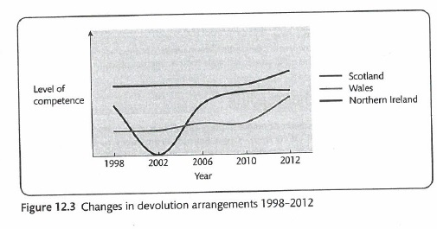
Asymmetric Devolution Arrangements?

Slide 82
The Devolved Parliaments:
Status of “Legislation”: Primary or Secondary?
There are three “locks” that guarantee the subordinate nature of legislative acts adopted by the devolved Parliaments. First, the Devolution Acts themselves acknowledge the “subordinate” status devolved legislation. Second, there is not much “purposive” constitutional rhetoric. Third, there are express limitations to the powers that are devolved.
“Sewel Convention”: “We would expect a convention to be established that Westminster would not normally legislate with regard to devolved matters in Scotland without the consent of the Scottish Parliament.”

Slide 83
The Devolved Parliaments:
The Scotland Act 2016 (March 2016)
Recognition of the Scottish Parliament and the Scottish Government as a permanent part of the United Kingdom’s constitutional arrangements
Introduction of a new paragraph (8) to section 28, codifying the Sewel Convention and putting it on a statutory footing
More competences on arbotion, taxation powers, and welfare policy

Slide 84
The “English” and “West Lothian” questions
England and Devolution
England remains the only territory within the United Kingdom without its own “devolved” Parliament. How then are the “English” represented; and or should Scottish, Welsh and Irish MPs be able to vote on Laws that exclusively affect England? This question about “England” was famously asked by the MP for “West Lothian”, and has since become known as “the English question”. According to Vernon Bogdanor, “there is only one logical answer to the West Lothian Question, but it is politically unrealistic: it is for Britain to implement legislative devolution all round.” That would mean an “English Parliament” (exclusion of the Scottish MPs etc.)?

Slide 85
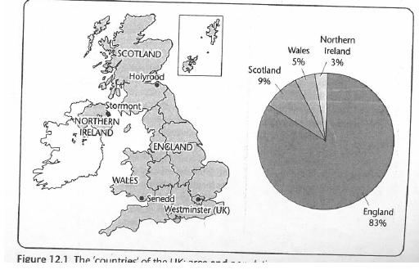
The “English” and “West Lothian” questions (2)

Slide 86
The “English” and “West Lothian” questions (3)
Partial solution to the “English Question”:
  “English Votes for English Laws” introduced within the House of Commons through a change to the Standing Orders (22 October 2015)
  The Speaker, through an Act of Certification, assess whether the bill: a) relates exclusively to England (and Wales): b) belongs to devolved legislative competences
  A Legislative Grand Committee where only English MPs can vote is introduced between the Report Stage and the Third Reading

Slide 87
Part IV: Italian Regionalism
“Sovereignty of the people” vs. “sovereignty of the Parliament”
The “ambivalence” of the Regions:
instruments of political decentralization vs.
territories claiming for differentiation
The asymmetric regionalism: Regions with ordinary status and Regions with special status
The federal/regional debate in drafting the Constitution

Slide 88
Part IV: Italian Regionalism
Article 5: a “federal” or “unitary” seed within the Constitution?
“The Republic, one and indivisible, recognises and promotes local autonomies, and implements the fullest measure of administrative decentralisation in those services which depend on the State. The Republic accords the principles and methods of its legislation to the requirements of autonomy and decentralisation”.

Slide 89
Regions in the 1948 Constitution
A “cooperative regionalism”…..
Art. 117 enumerates “shared competences” (belonging to both the State and the Regions):
Regions can only legislate in those areas:
a) provided that they only set out the details within a national normative framework envisaging general principles
b) provided that they do not affect national interest

Slide 90
Regions in the 1948 Constitution
….without national structures ensuring cooperation
The “perfect bicameralism” envisaged by the Constitution sees both the House of Deputies and the Senate to perform almost the same functions and to be directly elected by citizens
The Second Chamber (Senate) does not represent Regions although it is elected on a territorial basis

Slide 91
Regions in the 1948 Constitution
Regions as “constrained” legislatures
The pre-enactment scrutiny of Regional Laws:
a) At the political level: the necessity of a Governmental Officer’s assent
b) At the judicial level: the possibility of ex ante review before the Constitutional Court (this means that Regional law can be challenged by national Government before the Court before they enter into force)

Slide 92
The 2001 Constitutional Amendment
Art. 117: A new division of legislative powers
a) The exclusive powers of the State
b) The shared powers between State and the Regions
c) The “residual” powers of the Regions
Art. 118: A new allocation of administrative functions
The general competence of local authorities replaces the “principle of parallelism”

Slide 93
The 2001 Constitutional Amendment
Regional legislatures unconstrained:
The 2001 reform abolishes:
Political pre-enactment scrutiny (no more possible central supervision on regional bills)
Judicial pre-enactment scrutiny (no more possible ex ante judicial review of regional laws, only ex post)
The “respect for national interest” limitation in the field of share competences

Slide 94
Italian Constitutional Court as a “federal” court?
Explosion of competence conflicts between State and Regions after the 2001 amendment
The “decentralizing” force of the reform tempered by the “centralizing” twist of the Court case-law:
The narrow interpretation of “residual” competences
The broad interpretation of functional competences
The “prevalence” criteria in policing the boundaries
The “upward” dimension of subsidiarity

Slide 95
The Draft Constitutional Bill 2014-2016
The Senate as a “Federal” Second Chamber?
a) The House of Deputies will represent “the Nation” while the Senate will represent “territorial institutions”.
b) The Senate will no longer be directly elected. It will be composed by delegates of Regional assemblies and by one major per Region (both elected by the same Regional assemblies)
c) Erased the federal “equal” quota (it was in the first draft): no more two Senators per region but proportional representation

Slide 96
The Draft Constitutional Bill 2014-2016
A new division of legislative competences:
Abolishment of the “shared competences” category from the competence catalogue, which will espouse a “double enumeration model” (exclusive competences of the State, on the one hand, and competences of the Regions, on the other)
The “national interest” back in…but with the “political safeguard of federalism”

