Slide 1
Day 2: Lectures 3-4
Introduction
EU Federalism I: Foundations
EU Federalism II: Dual or Cooperative?

Slide 2
Introduction
The Problem: The history of the European Union and “federal” thought is a complex history that starts before the end of World War II (Count Coudenhove-Kalergi, and Spinelli). And when the three Communities are founded, “federalism” is seen as a useful “teleological” integration theory (Schuman Plan); yet with the collapse of the EDC and the EPC, federal thought is replaced by (neo-)functionalist thought; and despite some attempts to revive it (1984 Draft Treaty establishing a EU), it is not seen as a “real” intellectual contender…

Slide 3
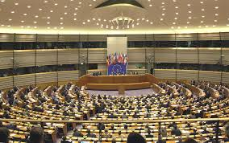

Treaty establishing a Constitution for Europe
Preamble of the Constitution
‘DRAWING INSPIRATION from the cultural, religious and humanist inheritance of Europe, from which have developed the universal values of the inviolable and inalienable rights of the human person, freedom, democracy, equality and the rule of law.’ (…)
‘CONVINCED that, while remaining proud of their own national identities and history, the peoples of Europe are determined to transcend their former divisions and, united ever more closely, to forge a common destiny.’

Slide 4
Federalist No.39 (1)
Foundational Dimension
    Unanimous assent of the States: „Each state in ratifying the Constitution, is considered as a sovereign body, independent of all others, and only to be bound by its own voluntary act.“
    Breach of the Articles of Confederation?
    „We, the people“ or „We, the peoples ...“?
    The amendment power under Article V: 2/3 Congress and ¾ States.

Slide 5
Federalist No.39 (2)
Institutional Dimenision
    The „great compromise“: the Union legislature will be bicameral. Congress is composed of a „House of Representatives“ and a „Senate“. Each law needs consent of both branches.
    The „President“: an elective monarch (and its „agents“ and „agencies“)
    The „Judiciary“: the Supreme Court (and lower federal courts).
    The Bank of America (McCulloch v Maryland)?

Slide 6
Federalist No.39 (3)
Substantive Dimension
    Federal powers are enumerated powers. Residual powers lie with the States. The list of legislative competences is established by Article I, Section 8 (eighteen clauses)
    Direct effect of federal laws on individuals

Slide 7
Foundational: We the Peoples?
We, the People (1)
D. Grimm: ‘[I]t is inherent in a constitution in the full sense of the term that it goes back to an act taken by or at least attributed to the people, in which they attribute political capacity to themselves. There is no such source for primary Union law. It goes back not to a European people but to the individual Member States, and remains dependent on them even after its entry into force. While nations give themselves a constitution, the European Union is given a constitution by third parties.’

Slide 8
We, the People (2)
J. Weiler: ‘In federations, whether American or Australian, German or Canadian, the institutions of a federal state are situated in a constitutional framework which presupposes the existence of a “constitutional demos”, a single pouvoir constituant made of the citizens of the federation in whose sovereignty, as a constituent power, and by whose supreme authority the specific constitutional arrangement is rooted[.] (…) In Europe, that precondition does not exist. (…) It is a constitution without some of the classic conditions of constitutionalism.

Slide 9
Federal Constitutionalism: “We, the Peoples”?
James Madison:
The 1787 Constitution had thus been ratified ‘by the people, not as individuals composing one entire nation, but as composing the distinct and independent States to which they respectively belong’.
‘Each State, in ratifying the Constitution, [was] considered as a sovereign body, independent of all others, and only to be bound by its own voluntary act.’ The 1787 Constitution was thus ‘a[n] [international], and not a national act’

Slide 10
Federal Constitutionalism: “We, the Peoples”?
Carl Schmitt:
The normative foundation of every union of States is a ‘federal treaty’. This ‘federal treaty’ is an international treaty of a constitutional nature. ‘Its conclusion is an act of the pouvoir constituant.’ Each Union of States is seen as a creature of international and national law.
A federal constitutional theory replaces the idea of a single sovereign subject with that of a pluralist constituent power. From the perspective of democratic constitutionalism, the constituent power behind a Union of States will thus be the State peoples instead of a single people.

Slide 11
Foundations II: Leaving…

Slide 12
Foundations III : Supremacy
Contested Supremacy:
  Costa v ENEL, Case 6/64 (1964)
  Internationale Handelsgesellschaft, Case 11/70, (1970)
  German Constitutional Court: “So-long” I (1974)
  German Constitutional Court: “So-long” II (1986)
  German Constitutional Court: “Maastricht” Decision (1993)

Slide 13
Costa v ENEL (1964)
“By contrast with ordinary international treaties, the E[U] Treaty has created its own legal system which, on the entry into force of the Treaty, became an integral part of the legal systems of the Member States and which their courts are bound to apply …
[T]he law stemming from the Treaty, an independent source of law, could not, because of its special and original nature, be overridden by domestic legal provisions, however framed, without being deprived of its character as [European] law and without the legal basis of the [Union] itself being called into question.”

Slide 14
German Supreme Court: “So-long I”
Provisionally, therefore, in the hypothetical case of a conflict between [European] law and a part of national constitutional law or, more precisely, of the guarantees of fundamental rights in the Constitution, there arises the question of which system of law takes precedence, that is, ousts the other. In this conflict of norms, the guarantee of fundamental rights in the Constitution prevails so long as the competent organs of the [Union] have not removed the conflict of norms in accordance with the Treaty mechanism.

Slide 15
German Supreme Court: “Maastricht”
Thus, if European institutions or agencies were to treat or develop the Union Treaty in a way that was no longer covered by the Treaty in the form that is the basis for the Act of Accession, the resultant legislative instruments would not be legally binding within the sphere of German sovereignty. The German state organs would be prevented for constitutional reasons from applying them in Germany. Accordingly the Federal Constitutional Court will review legal instruments of European institutions and agencies to see whether they remain within the limits of the sovereign rights conferred on them or transgress them.

Slide 16
Constitutional Pluralism (Walker)
EU law [] poses the most pressing paradigm-challenging test to what we might call constitutional monism. Constitutional monism merely grants a label to the defining assumption of constitutionalism in the Westphalian age . . . namely the idea that the sole centres or units of constitutional authorities are states. Constitutional pluralism, by contrast, recognizes that the European legal order inaugurated by the Treaty of Rome has developed beyond the traditional confines of inter-national law and now makes its own independent constitutional claims exist alongside the continuing claims of states.”

Slide 17
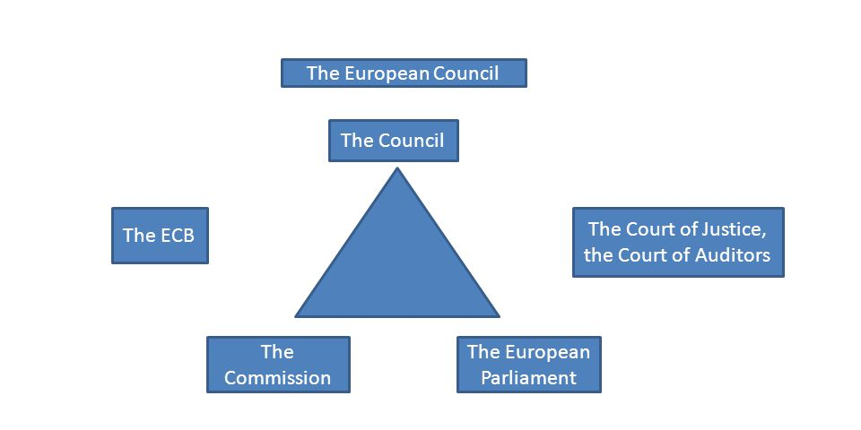
Institutional Dimension

Slide 18
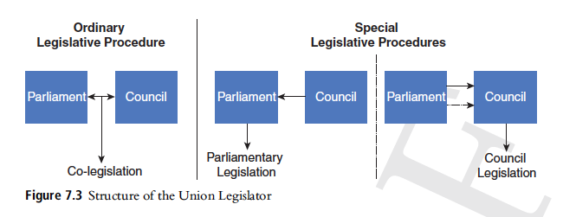
European Legislature

Slide 19
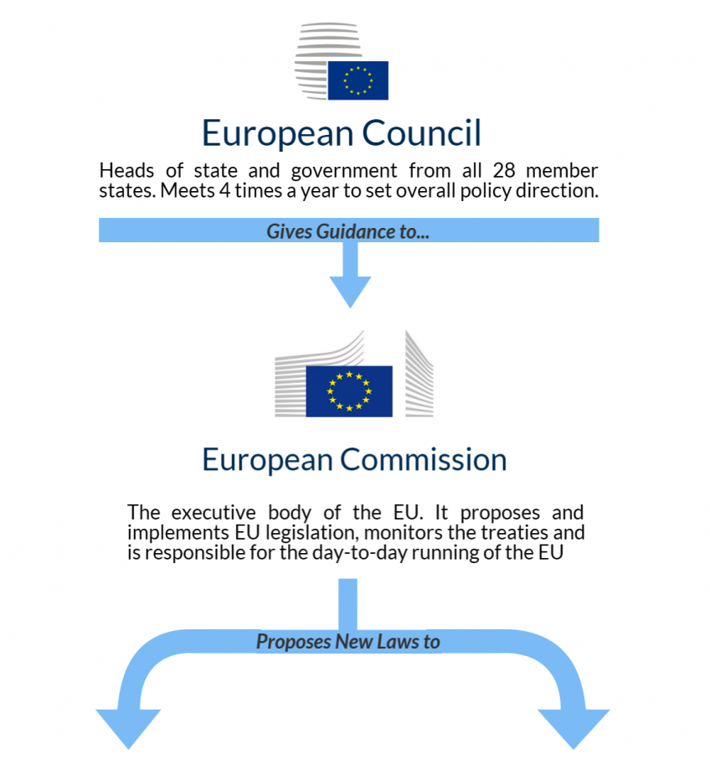
European Executive

Slide 20

European Judiciary

Slide 21
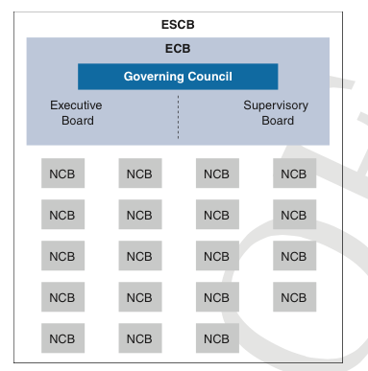
Financial Institution(s)

Slide 22
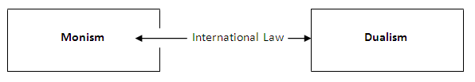
Functional Dimension

Slide 23
Van Gend en Loos, Case 26/62
“The objective of the [European Treaty], which is to establish a Common Market, the functioning of which is of direct concern to interested parties in the [Union], implies that this Treaty is more than an agreement which merely creates mutual obligations between the contracting parties … It is also confirmed more specifically by the establishment of institutions endowed with sovereign rights …
The conclusion to be drawn from this is that the [Union] constitutes a new legal order of international law for the benefit of which the states have limited their sovereign rights, albeit within limited fields, and the subjects of which comprise not only Member States but also their nationals. Independently of the legislation of Member States, Community law therefore not only imposes obligations on individuals but is also intended to confer upon them rights which become part of their legal heritage.”

Slide 24
Division of Powers
Three Principles: conferral, subsidiarity, proportionality
(1) & (2) Conferral: “Under the principle of conferral, the Union shall act only within the limits of the competences conferred upon it by the Member States in the Treaties to attain the objectives set out therein. Competences not conferred upon the Union in the Treaties remain with the Member States.”

Slide 25
The EU/TFEU Treaties
European Union
EU Treaty |  |  | FEU Treaty
Title I | Common Provisions |  | Part I | Principles
Title II | Democratic Principles |  | Part II | Citizenship (Non-Discrimination)
Title III | Institutions |  | Part III | Union (Internal) Policies
Title IV | Enhanced Cooperation |  | Part IV | Overseas Associations
Title V | External Action, and CFSP |  | Part V | External Action
Title VI | Final Provisions |  | Part VI | Institutions & Finances
 |  |  | Part VII | General & Final Provisions
Charter of Fundamental Rights
Protocols (37)
Declarations (65)

Slide 26
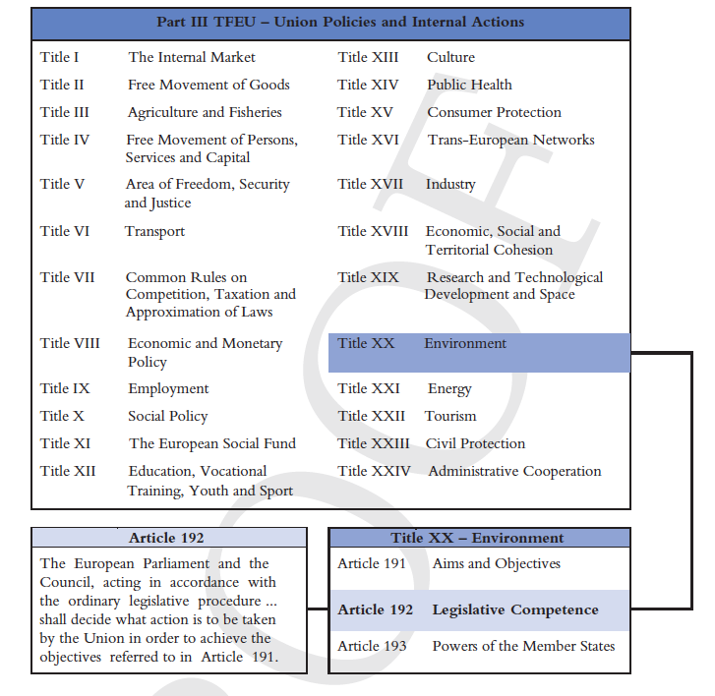

Slide 27
What about the executive powers?
The Union is based on the principle of conferral, but where are the Union’s executive powers? The vast majority of its competences were originally “legislative” competences; and executive powers were expressly attributed in – very – few areas indeed.

Slide 28
Article 114 TFEU
The Union’s internal market competence under Article 114 TFEU allows the Union to adopt “measures for the approximation of the provisions laid down by law, regulation or administrative action in Member States”. The power to adopt “measures” appeared to include the power to adopt individual decisions.

Slide 29
Germany v Council (Product Safety Directive)
Case C-359/92
In certain fields, and particularly in that of product safety, the approximation of general laws alone may not be sufficient to ensure the unity of the market. Consequently, the concept of "measures for the approximation" of legislation must be interpreted as encompassing the [Union]' s power to lay down measures relating to a specific product or class of products and, if necessary, individual measures concerning those products.

Slide 30
Article 352 TFEU
And an even more general legal basis for the adoption of administrative measures may be available to the European Union: Article 352 TFEU. The article allows the Union to “adopt the appropriate measures”, where this is necessary to attain one of the objectives set out in the Treaties. This power includes the competence to adopt administrative decisions.
Administrative Infrastructure: Agencies!

Slide 31
Decentralization Model…?
Article 291 (1) TFEU
“Member States shall adopt all measures of national law necessary to implement legally binding Union acts”; but where “uniform conditions for implementing legally binding Union acts are needed”, the Union shall adopt the executive act.

Slide 32
Judicial Competences?
Article 19 (3) TEU
The Court of Justice of the European Union shall, in accordance with the Treaties:
rule on actions brought by a Member State, an institution or a natural or legal person;
give preliminary rulings, at the request of courts or tribunals of the Member States, on the interpretation of Union law or the validity of acts adopted by the institutions.

Slide 33
Union Competences: 2 traditional ones
  Exclusive: Article 2 (1) TFEU. When the Treaties confer on the Union exclusive competence in a specific area, only the Union may legislate and adopt legally binding acts, the Member States being able to do so themselves only if so empowered by the Union or for the implementation of Union acts.”
  Shared: Article 2 (2) TFEU: When the Treaties confer on the Union a competence shared with the Member States in a specific area, the Union and the Member States may legislate and adopt legally binding acts in that area. The Member States shall exercise their competence to the extent that the Union has not exercised its competence. The Member States shall again exercise their competence to the extent that the Union has decided to cease exercising its competence…

Slide 34
… 2 plus 1 non-traditional ones…
Coordinating: Article 2(3) TFEU: The Member States shall coordinate their economic and employment policies within arrangements as determined by this Treaty, which the Union shall have competence to provide.
CFSP Competence: Article 2(4) TFEU: The Union shall have competence, in accordance with the provisions of the Treaty on European Union, to define and implement a common foreign and security policy, including the progressive framing of a common defence policy.
  Complementary: Article 2(5) TFEU: “In certain areas and under the conditions laid down in the Treaties, the Union shall have competence to carry out actions to support, coordinate or supplement the actions of the Member States, without thereby superseding their competence in these areas. Legally binding acts of the Union adopted on the basis of the provisions of the Treaties relating to these areas shall not entail harmonisation of Member States’ laws or regulations.”

Slide 36
Exclusive Competences: Article 3
customs union;
the establishing of the competition rules necessary for the functioning of the internal market;
monetary policy for the Member States whose currency is the euro;
the conservation of marine biological resources under the common fisheries policy;
common commercial policy.

Slide 37
Shared Competences (Art. 4)
1. The Union shall share competence with the Member States where the Treaties confer on it a competence which does not relate to the areas referred to in Articles 3 and 6.
2. Shared competence between the Union and the Member States applies in the following principal areas:
(a) internal market; (b) social policy, for the aspects defined in this Treaty; (c) economic, social and territorial cohesion; (d) agriculture and fisheries, excluding the conservation of marine biological resources; (e) environment …

Slide 38
Coordinating Competences (Art. 5)
1. The Member States shall coordinate their economic policies within the Union. To this end, the Council shall adopt measures, in particular broad guidelines for these policies. Specific provisions shall apply to those Member States whose currency is the euro.
2. The Union shall take measures to ensure coordination of the employment policies of the Member States, in particular by defining guidelines for these policies.
3. The Union may take initiatives to ensure coordination of Member States' social policies.

Slide 39
Complementary Competences (Art. 6)
(a) protection and improvement of human health;
(b) industry;
(c) culture;
(d) tourism;
(e) education, vocational training, youth and sport;
(f) civil protection;
(g) administrative cooperation.

Slide 40
External Competences
History
Under the 1957 Rome Treaty, the European Union only enjoyed two express treaty-making powers: one with regard to the Common Commercial Policy, and the other with regard to Association Agreements, but…

Slide 41
ERTA
The competence to conclude international agreements “arises not only from an express conferment by the Treaty”, “but may equally flow from other provisions of the Treaty and from measures adopted, within the framework of those provisions, by the [Union] institutions”
… but this case is badly codified in…

Slide 42
Article 216 TFEU
The Union may conclude an agreement with one or more third countries or international organisations where the Treaties so provide or where the conclusion of an agreement is necessary in order to achieve, within the framework of the Union’s policies, one of the objectives referred to in the Treaties, or is provided for in a legally binding Union act or is likely to affect common rules or alter their scope.

Slide 43
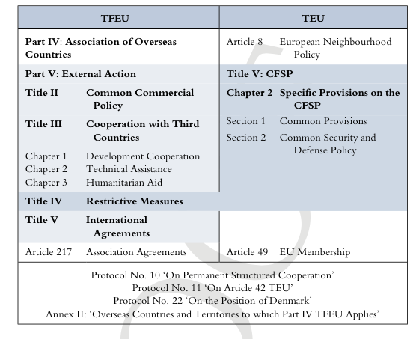

Slide 44
3. Nature of External Competences
The Treaties do – as a rule – not distinguish between internal and external competences. And indeed: within the areas of Union competences listed in Articles 3-6 TFEU, we find a number of external competences.

Slide 46
Exclusive Competences (Art. 3)
customs union;
the establishing of the competition rules necessary for the functioning of the internal market;
monetary policy for the Member States whose currency is the euro;
the conservation of marine biological resources under the common fisheries policy;
common commercial policy.

Slide 47
Shared Competence (Art.4)
2. … Shared competence between the Union and the Member States applies in the following principal areas:
4. In the areas of development cooperation and humanitarian aid, the Union shall have competence to carry out activities and conduct a common policy…

Slide 48
… yet:
There are two exceptions to this rule.
First, Article 2 TFEU specifically isolates the Union’s CFSP competence from its ordinary competence categories – an arrangement that suggests a sui generis competence.
Second, Article 3 (2) TFEU provides a source of exclusivity for the conclusion of international agreements that goes beyond the competence areas listed in Article 3(1) TFEU.

Slide 49
CFSP Competence?
We might find a first key to this question in Article 24 TEU dealing with the nature of the CFSP competence. The provision declares that ‘[t]he adoption of legislative acts shall be excluded’ within the CFSP area. What will this mean? If the reference to ‘legislative acts’ were given a formal meaning, that is: referring to acts adopted under a legislative procedure, then Article 24 TEU would state the obviousBy contrast, if the formulation is given a material meaning, then Article 24 TEU signalled the exclusion of generally applicable CFSP norms.

Slide 50
Subsequently Exclusive Competences
Article 3(2) TFEU
The Union shall also have exclusive competence for the conclusion of an international agreement when its conclusion is provided for in a legislative act of the Union or is necessary to enable the Union to exercise its internal competence, or in so far as its conclusion may affect common rules or alter their scope.

Slide 51
Article 3(2): Three Situations
These three situations correspond to three famous cases…
Situation 1: where conclusion of an international agreement “is provided for in a legislative act”. This corresponds to the “Opinion 1/94 (WTO) Doctrine”.
Situation 2: where this “is necessary to enable the Union to exercise its internal competence”. This codify the “Opinion 1/76 Doctrine”
Situation 3: where Union has adopted internal legislation. This codifies the “ERTA Doctrine”.

Slide 52
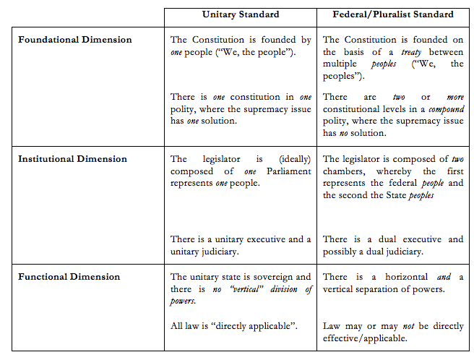
Part I… Conclusions…

Slide 53
Today: Part II
EU Federalism: Dual or Cooperative?
What I am not going to talk about
What I am going to talk about
  The Decline of Constitutional Exclusivity
  The Decline of Legislative Exclusivity
  Cooperative Federalism Constitutionalised…

Slide 54
What we are not talking about … I

Slide 55
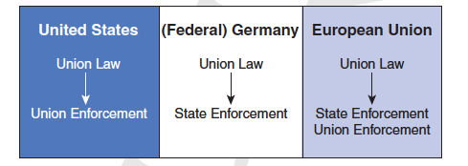
What we are not talking about … II

Slide 56
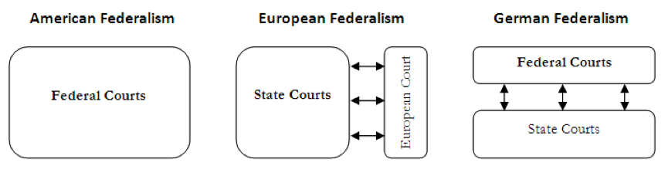
What we are not talking about … III

Slide 57
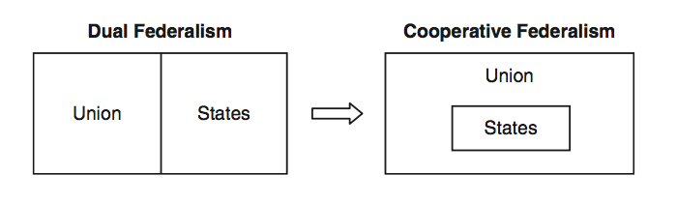
What we are not talking about … I

Slide 58
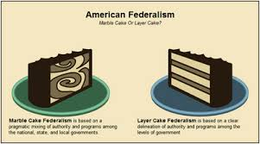
What we are not talking about … II

Slide 59
EU Law: From Dual to Cooperative Federalism?
In order to discover whether the structure of European Union law has changed from two areas of mutual exclusivity to an area in in which both the Union and the Member States act, we need to explore this:
Decline of constitutional exclusivity: do the competence spheres overlap? ( Decline of National Exclusive Powers)
Decline of legislative exclusivity: do European and national laws overlap?
Constitutionalizing Cooperative Federalism

Slide 60
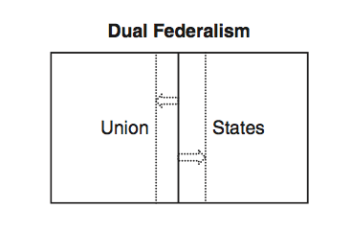
Why legislative exclusivity is decisive…

Slide 61
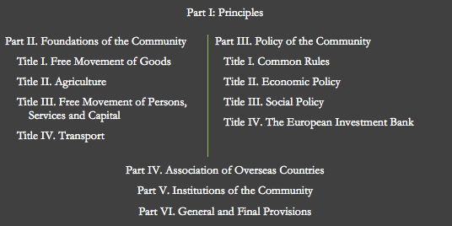
A. The Decline of National Exclusive Powers

Slide 62
Title: Social Policy
(former wording)
The Union is entitled to „encourage improvements, especially in the working environment, as regards the health and safety of workers.“

Slide 63
UK v Council, Case 84/94
15 ‘There is nothing in the wording of Article [153] to indicate that the concepts of "working environment", "safety" and "health" as used in that provision should, in the absence of other indications, be interpreted restrictively, and not as embracing all factors, physical or otherwise, capable of affecting the health and safety of the worker in his working environment, including in particular certain aspects of the organization of working time.’

Slide 64
General Competences I
Article 352 TFEU:
“If action by the Union should prove necessary, within the framework of the policies defined in the Treaties, to attain one of the objectives set out in the Treaties, and the Treaties have not provided the necessary powers, the Council, acting unanimously on a proposal from the Commission and after obtaining the consent of the European Parliament, shall adopt the appropriate measures.”

Slide 65
Textbook Illustration
The textbook illustration for the dramatic expansion of Europe’s competence sphere on the basis of Article 352 is provided by the Union’s environmental policy. Stimulated by the political enthusiasm of the Member States after the Paris Summit, the Commission and the Council faced the legal problem that environmental policy was not an official Community activity. There was therefore no specific legal title offered by the Treaty. The way out of this dilemma had been suggested in the 1972 Paris Communiqué. It called on the Community institutions to make the widest possible use of all provisions of the Treaties, including Article 352.

Slide 66
Opinion 2/94 (ECHR Accession)
29. Article [352] is designed to fill the gap where no specific provisions of the Treaty confer on the [Union] institutions express or implied powers to act, if such powers appear none the less to be necessary to enable the [Union] to carry out its functions with a view to attaining one of the objectives laid down by the Treaty. (...) Accession to the Convention would, however, entail a substantial change in the present [Union] system for the protection of human rights in that it would entail the entry of the [Union] into a distinct international institutional system as well as the integration of all the provisions of the Convention into the [Union] legal order.

Slide 67
General Competences II
Article 114 TFEU
“The European Parliament and the Council shall, acting in accordance with the ordinary legislative procedure and after consulting the Economic and Social Committee, adopt the measures for the approximation of the provisions laid down by law, regulation or administrative action in Member States which have as their object the establishment and functioning of the internal market.”

Slide 68
Famous Challenges to Legal Acts
Spain v Council, Case 350/92
EU law aimed „to prevent the heterogeneous development of national laws leading to further disparities which would be likely to create obstacles to the free movement of medicinal products within the Union“.

Slide 69
Germany v Parliament & Council (Tobacco Advertising), Case 376/98
84. Moreover, a measure adopted on the basis of Article [114] of the Treaty must genuinely have as its object the improvement of the conditions for the establishment and functioning of the internal market. If a mere finding of disparities between national rules and of the abstract risk of obstacles to the exercise of fundamental freedoms or of distortions of competition liable to result therefrom were sufficient to justify the choice of Article [114] as a legal basis, judicial review of compliance with the proper legal basis might be rendered nugatory. The Court would then be prevented from discharging the function entrusted to it by Article [19 TEU] of ensuring that the law is observed in the interpretation and application of the Treaty.

Slide 70
B. Rising Legislative Overlap?
Shared competences permit two legislators to adopt their laws within the same area and at the same time. Since competences are potentialities— entitlements for future legislation—shared competences within a federal legal order will only provide abstract guidelines about the legislative responsibilities of either government.
And since two legislative wills may come into conflict, each federal legal order opting for shared competences will have to determine when conflicts arise and how these conflicts are to be resolved. In Europe’s constitutionalism they have been described as, respectively, the principle of pre-emption and the principle of supremacy….

Slide 71
Union Harmonization….
In the past, the Union has developed different harmonisation methods. The use of any such method is not constitutionally prescribed by Articles 114 et seq. It falls within the political discretion of the Union legislator. In some situations, the Union may wish to exhaustively harmonise an area and totally pre-empt all national action within the harmonised field. Field pre-emption is based on the idea of two mutually exclusive legal spheres – a federal arrangement that is commonly called ‘dual federalism’. By contrast, Union legislation may also accept – higher – national standards. Here, European and national law ‘complement’ each other in a federal arrangement that is commonly called cooperative federalism.

Slide 72
Old approach to harmonization I
Ratti, Case 148/78
“… not entitled to maintain, parallel with the rules laid down by the Directive for imports, different rules for the domestic market. Thus it is a consequence of the system introduced by Directive No 73/173 that a Member State may not introduce into its national legislation conditions which are more restrictive than those laid down in the Directive in question, or which are even more detailed or in any event different, as regards the classification, packaging and labelling of solvents and that this prohibition on the imposition of restrictions not provided for applies both to the direct marketing of the products on the home market and to imported products.”

Slide 73
Old approach to harmonization II
Simmenthal, Case 35/76
[W]hen, pursuant to [Article 115] of the Treaty, [Union] directives provide for the harmonization of measures necessary to ensure the protection of the health of humans and animals and establish [Union] procedures to supervise compliance therewith, recourse to [Article 36] ceases to be justified.

Slide 74
New Approach to Harmonization I
1985 White Paper on the Internal Market
The real innovation of the White Paper lay in the conception of a ‘new approach to technical harmonisation’. Legislative harmonisation of product requirements would – henceforth – be restricted to essential health and safety requirements. Surprisingly, the White Paper did not expressly mention minimum harmonisation. However, due to the changed ‘object’ of harmonisation, the new approach was ultimately more susceptible to minimum harmonisation. And the rise of mutual recognition to become the best – federal – solution within the internal market ultimately triggered the rise of minimum harmonisation.

Slide 75
….an example: Gallaher, Case C-11/92
“The expression ‘at least’ contained in both articles must be interpreted as meaning that, if they consider it necessary, Member States are at liberty to decide that the indications and warnings are to cover a greater surface area in view of the level of public awareness of the health risks associated with tobacco consumption . . . [T]his interpretation of the provisions may imply less favourable treatment for national products in comparison with imported products and leaves in existence some inequalities in conditions of competition. However, those consequences are attributable to the degree of harmonization sought by the provisions in question, which lay down minimum requirements.”

Slide 76
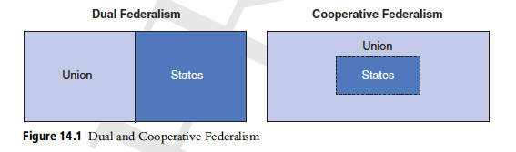
Interim Conclusion…

Slide 77
C. Cooperation Constitutionalised?
Since the Single European Act, two constitutional phenomena have “constitutionalised” the cooperative relationship between European and national law, namely through the Subsidiarity Principle … and…complementary (minimum harmonization competences….

Slide 78
EU Subsidiarity
  Evolution:
1975 “Report on European Union”
1984 “Draft Treaty Establishing the European Union” (two versions of the principle)
1986 Single European Act: Environmental Policy and subsidiarity
1992 (Maastricht) Treaty on European Union
1997 Treaty of Amsterdam
2009 Lisbon Treaty

Slide 79
EU Subsidiarity
Report on European Union (1975)
No more than the existing Communities have done so, the European Union is not to give birth to a centralizing super-state. Consequently, and in accordance with the principe de subsidiarité, the Union will be given responsibility only for those matters which the Member States are no longer capable of dealing with efficiently.’ ‘[I]n deciding on the Union’s competence, application of the principe de subsidiarité is restricted by the fact that the Union must be given extensive enough competency for its cohesion to be ensured’

Slide 80
Single European Act (1987)
Article 130r(4) EEC stated: ‘The Community shall take action relating to the environment to the extent to which the objectives referred to in paragraph 1 can be attained better at Community level than at the level of the individual Member States’.

Slide 81
Edinburgh Guidelines (1992)
‘[B]oth aspects of the subsidiarity criterion are met: the objectives of the proposed action cannot be sufficiency achieved by Member States’ action and they can therefore be better achieved by action on the part of the Community’. In assessing the insufficiency test, the transnational aspects of a problem as well as the Union’s commitment to creating an internal market should be taken into account. As regards the comparative efficiency test, the Edinburgh Guidelines insist that Community action would need to ‘produce clear benefits by reason of its scale or effects compared with action at the level of the Member States’.

Slide 82
Subsidiarity (Maastricht/Lisbon)
Article 5 (3) TEU
Under the principle of subsidiarity, in areas which do not fall within its exclusive competence, the Union shall act only if and in so far as the objectives of the proposed action cannot be sufficiently achieved by the Member States, either at central level or at regional and local level, but can rather, by reason of the scale or effects of the proposed action, be better achieved at Union level.

Slide 83
Subsidiarity Test: Problems
Two tests? “National Insufficiency Test” versus “Comparative Efficiency Test”
Two versions? “If and in so far” following an “either-or” logic or rather a “to what extent” logic?
Collective actions by all Member States?

Slide 84
Substantive Standard:
United Kingdom v Council (Working Time)
Case C-84/94
Choice 1:
Once the Council has found that it is necessary to improve the existing level of protection as regards the health and safety of workers and to harmonize the conditions in this area while maintaining the improvements made, achievement of that objective through the imposition of minimum requirements necessarily presupposes Community-wide action, which otherwise, as in this case, leaves the enactment of the detailed implementing provisions required largely to the Member States.

Slide 85
Choice 2
‘[T]he Council must be allowed a wide discretion in an area which, as here, involves the legislature in making social policy choices and requires it to carry out complex assessments’. ‘Judicial review of the exercise of that discretion must therefore be limited to examining whether it has been vitiated by manifest error or misuse of powers, or whether the institution concerned has manifestly exceeded the limits of its discretion’

Slide 86
Subsidiarity: Procedural Standard I
Lisbon Protocol – Article 6
Any national Parliament or any chamber of a national Parliament may, within eight weeks from the date of transmission of a draft legislative act, in the official languages of the Union, send to the Presidents of the European Parliament, the Council and the Commission a reasoned opinion stating why it considers that the draft in question does not comply with the principle of subsidiarity. It will be for each national Parliament or each chamber of a national Parliament to consult, where appropriate, regional parliaments with legislative powers.

Slide 87
Subsidiarity: Procedural Standard I
Lisbon Protocol – Article 7
“Each national Parliament shall have two votes, shared out on the basis of the national Parliamentary system. In the case of a bicameral Parliamentary system, each of the two chambers shall have one vote.
Where reasoned opinions on a draft legislative act’s non-compliance with the principle of subsidiarity represent at least one third of all the votes allocated to the national Parliaments in accordance with the second subparagraph of paragraph 1, the draft must be reviewed.

Slide 88
A Political Solution?
“Yellow Card” Mechanism (special legislative procedures)
“Orange Card” Mechanism (ordinary legislative procedure”, but no “Red Card” Mechanism, but current discussion in the United Kingdom…
First application: Monti II Regulation= Commission's Proposal for a Council regulation on the exercise of the right to take collective action within the context of the freedom of establishment and the freedom to provide services.

Slide 89
Better Subsidiarity Review
Ex ante judicial Review?
„Subsidiarity Court“?
„Clear Statement Rules“ imposed on the Union legislator?
More judicial “activism” (on behalf of the States)?

Slide 90
b. Complementary Competences

Slide 91
Complementary Competences: Origins I
The method of constitutionally fixing minimum harmonization emerged for the first time in relation to environmental and social policy. Subsequent amendments have extended this technique to other areas. The constitutional relationship between the European and the national legislator is here relatively straightforward: the Treaty guarantee the ability of the national legislator to adopt higher standards. The legislative cooperation is thus a result of the constitutional structure of the competence as such. This particularity sets them apart from ‘normal’ shared competences.

Slide 92
Example: Environmental Policy
According to Article 193 TFEU, European laws “shall not prevent any Member State from maintaining or introducing more stringent protective measures”. Union laws are consequently confined to laying down minimum standards that must permit national ‘opt-ups’.
The central question however is this: must all EU environmental laws be minimum harmonisation measures; or does Article 193 TFEU only ‘softly’ require the Union legislator to leave some – abstractly defined – legislative space to the national legislators? Surprisingly, after almost three decades of constitutional practice, the issue has not been definitely resolved.

Slide 93
Two Views…
Two views are possible. According to a first view, Article 193 will not constitutionally prevent the Union legislator from adopting specific legislative acts that totally harmonise all matters within their scope. This first view therefore only deposits a strong presumption against field preemption – codified in Article 193; while the Union legislator faces no absolute constitutional limitation to exhaustively harmonise a specific environmental issue. By contrast, a second view argues that Article 193 TFEU refers to every single piece of European legislation. Each Union act must thus leave a degree of legislative space to the national legislators.

Slide 94
Azienda Agro-Zootecnica Franchini, Case C-2/10
“It should be noted in this regard that European Union rules do not seek to effect complete harmonisation in the area of the environment. Article 14 of the Birds Directive provides that Member States may introduce stricter protective measures than those provided for under that directive. There is no provision in the Habitats Directive that is equivalent to Article 14 of the Birds Directive. Nevertheless, since that directive was adopted on the basis of Article 192 TFEU, it should be noted that Article 193 TFEU provides that Member States may adopt more stringent protective measures….

Slide 95
Complementary Competences: Origins II
A second variant of constitutionally enshrined cooperative federalism appears with the Maastricht Treaty. Instead of referring to ‘minimum’ standards, the Treaty characterizes the power of the Community legislator as ‘complementing’ or ‘supplementing’ national action. The contours of this type of competence are still largely unexplored, especially as some of these competences introduce the concept of ‘incentive measures’ that may exclude all harmonization within the field

Slide 96
An Example: Public Health
Article 168(1) and (2) TFEU
“Union action, which shall complement national policies, shall be directed towards improving public health, preventing physical and mental illness and diseases, and obviating sources of danger to physical and mental health. (...) The Union shall encourage cooperation between the Member States in the areas referred to in this Article and, if necessary, lend support to their action. It shall in particular encourage cooperation between the Member States to improve the complementarity of their health services in cross-border areas.”

Slide 97
?????
The contours of this competence type are largely unexplored by jurisprudence. However, after the Lisbon reform, it appears to be a defining characteristic of complementary competences that they do ‘not entail harmonisation of Member States’ laws or regulations’. The formulation suggests the Union’s intent to guarantee legislative space to the Member States. But what exactly is the prohibition of harmonisation supposed to mean?

Slide 98
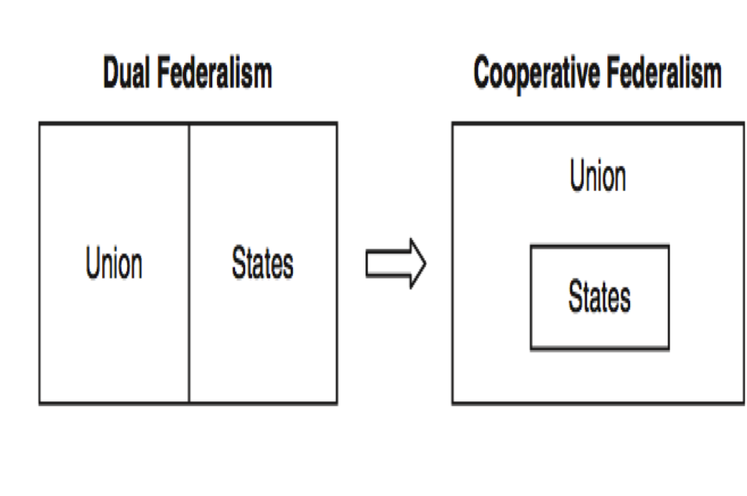
Conclusion…

Slide 99
What we didn’t do…
… is to look at the external relations aspects of the changing structure of European law. For here we find a predominantly dual federalism… the reasons for this are… but even here, there are signs of a more cooperative relationship… but this is for another time…
Thank you, and goodbye!

